Slide 1
From Braiding to Building: Concrete Ideas for Integrating Initiatives Under the Guided Pathways Framework
Download this presentation:
bit.ly/gfsf-braiding

Slide 2
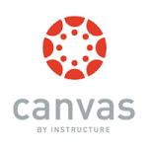
Look at all we’ve done!
California Career Pathways Trust (CCPT)
STUDENT SUCCESS AND SUPPORT PROGRAM (SSSP)
Basic Skills and Student Outcomes Transformation Program

Slide 3
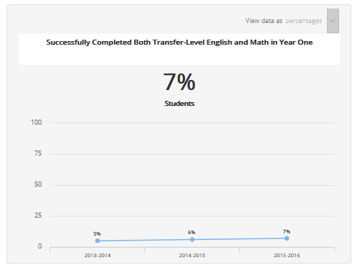
And yet, students still struggle

Slide 4
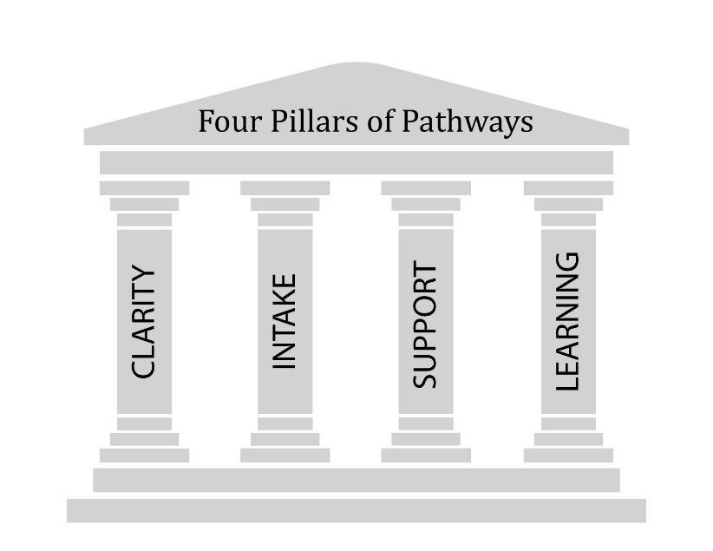
EQUITY
SSSP
EQUITY
EQUITY
SSSP
California Career Pathways Trust (CCPT)
Co-Requisites
Noncredit
Supplemental Instruction/Tutoring
Contextualized Learning
BSI e-Resource
Equity, Social Mobility, Economic Health for All Students
Notes:
The Four Pillars of the Pathway – Math Competencies, Science Competencies, Academic Literacy

Slide 5
EQUITY

Slide 6
Clarity
Have faculty and student services professionals work together to create clear program maps
Group related skill-sets into meta-majors
Document specific course sequences for certificates and degrees
Flag key progress milestones
Identify regional employment opportunities and related majors at four-year institutions
Resources:
C-ID/Associate Degrees for Transfer
California Career Pathways Trust
Adult Education Block Grants
Strong Workforce Program
Your ideas…

Slide 7
Intake
1) Ensure students enter with the skills they need
Coordinate with the K-12 and adult educational continuum to ensure students are learning the pre-requisite skills for college coursework and pathways
Strengthen multiple measures assessment to better understand students’ abilities
2) Link educational planning to long-term goals
Examine career options, possible majors, and transfer pathways to set goals
Help students pick meta-major in their first term and select the appropriate courses for that area
3) Restructure foundational English and Math courses
Align basic skills options with programs of study
Integrate skills beyond English and Math that are needed for gateway courses
Reduce time in remediation through acceleration, contextualization, co-requisites

Slide 8
Intake
1) Ensure students enter with the skills they need
Resources: Basic Skills Initiative, AB705, SSSP, AEBG, K-14 Pathways, dual enrollment, summer bridge
2) Link educational planning to long-term goals
Resources: Educational Planning Initiative, CCCMyPath, Here to Career, Career Café, Equity Funding, Strong Workforce Program, SSSP, GFSF
3) Restructure foundational Math and English courses
Resources: Basic Skills Initiative, Basic Skills Transformation Grants
What else are your colleges leveraging to improve intake?

Slide 9
Support
1) Adjust college structures that impede student progress
Simplify decision-making by providing sample schedules and information on how choices affect longer-term goals
Provide predictable schedules and schedule the courses in a way that ensures students can complete their majors
2) Track student progress within pathways
Ensure students know how far they have progressed and what to do next
Monitor student progress and develop mechanisms for reaching out to students who are off-track
Embed academic and non-academic supports into programs
Resources: Equity Funding, SSSP Funding, Educational Planning Initiative, Student Support (Re)defined, EOPS, DSPS, Umoja, Puente, MESA, learning communities
What else are your colleges leveraging to improve support?

Slide 10
Learning
1) Focus on program-level learning outcomes
Align to key skills needed in the workplace
Address how outcomes address transfer requirements
Build essential skills across individual courses
2) Emphasize the quality of learning
Deepen learning to build critical thinking, collaboration, and problem-solving in addition to narrower skill-sets
Leverage learning outcomes assessment to improve instruction
Provide professional development opportunities to strengthen effective teaching practices and strengthen collaboration among faculty
Build in active-learning opportunities, work-based learning, and apprenticeships
Resources: C-ID, Online Education Initiative, Institutional Effectiveness Partnership Initiative, Strong Workforce Program, accreditation
What else are your colleges leveraging to improve learning?

Slide 11
Taking Action
What additional information would help you with aligning existing efforts with guided pathways?
Could you work with the guided pathways implementation team at your college to map existing work against the reform framework?
Who could you work with on your campus to bring these efforts together?
Who are the external partners that you could leverage?

